Slide 1

PROJECT EXHIBITION II
(Final Review/Group 303)
Project Guide: Dr. Sambasivam G

Slide 2


GYM MANAGEMENT SYSTEM

Slide 3



TEAM MEMBERS
STUTI SHARMA
ANIMESH
PALIWAL
PRIYANSHU RANJAN
ZUHAIR KHAN
21BCE10748
21BCE10656
21BCE11044
21BCE10694

Slide 4


Welcome to our presentation on the Gym Management System. Our project aims to provide an efficient and user-friendly way to manage gym operations. In this presentation, we will discuss the proposed work and methodology, and showcase the implementation, testing and results of the system.

Slide 5
WHY?
With the best facilities for fitness, physical activity, and bodybuilding available to our culture, gyms have become an essential part of life for a lot of people. As a result, maintaining the records of each individual, including trainers, trainees, and staff, requires certain management-side actions. However, keeping paper records is quite challenging. Most gyms usually use a manual system to record data. The UI of the current system is not user-friendly. The information about the members is manually written down and kept track of. Therefore, a computerized system that handles all of these is required.

Slide 6


Existing Manual System
No proper system/management.
Time-consuming and Inefficient.
Requires more manpower as the system is manual.
Important information can be missed while writing on a page.
Very likely to have an error.
Everything is done on paper, which is very prone to damage and needs a lot of storage space and security.

Slide 7
PROPOSED WORK
The proposed gym management system aims to automate and streamline the operations of a gym by providing a user-friendly interface that gym administrator can use to easily manage various aspects of their gym, such as member registration and updation of plans/packages, etc.
This system will help to improve the overall efficiency of gym operations, provide a better customer experience for members, and help gym managers to focus on other important aspects of managing their gym.

Slide 8

Proper system to save the record in the database.
Fast and easy to use.
Full fledge information system.
Efficient and proper availability.
Less time consuming.

Slide 9
OBJECTIVE
To design and develop a comprehensive gym management system that automates key gym operations, such as member management, class scheduling, and other important operations.
To provide an efficient and user-friendly way to manage gym operations.
To eliminate time-consuming data entry and get rid of the paperwork/manual system in the fitness centres.
To reduce the need for manpower to maintain records
To provide secure storage for records with easy retrieval.

Slide 10


METHODOLOGY
Analyze the current manual gym management system and identify its limitations.
Gather requirements for the proposed system.
Design the system architecture and database schema.
Develop the system using suitable software tools and technologies.
Test the system for functionality, usability, and security.
Implement the system and provide staff and client training.
Conduct ongoing maintenance and updates to ensure the system's continued effectiveness.

Slide 11
The gym management system will have a simple and user-friendly interface, allowing gym staff to quickly add, edit, and delete member records, and make it easy for administrators and members to navigate and use the system
User-Friendly Interface
NOVELTY OF THE PROJECT
The system will have a membership management module that will allow gym staff to manage the memberships of the gym members, including tracking the start and end dates of the memberships,
Membership Management
The system will provide an easy way to manage different gym packages and plans, including monthly subscriptions, one-time fees, and special promotions.
Packages
and more...

Slide 12
Hardware Requirements
Processor: Intel Core i3 or above
Processor Speed: 1.8 GHz or higher
RAM: 2 GB or above
Hard Disk: 50 GB or above
Display Monitor: 15-inch or above with 1024x768 resolution
Input Devices: Keyboard and Mouse
Internet connection: Broadband or faster

Slide 13
Software Requirements
The project will be created under the domain of Web development.
Operating System: Windows (version 7 or higher) or any equivalent OS
Web Browser: Google Chrome or any compatible browser.
Client-side scripting language: HTML, CSS, JavaScript
Server-side scripting language: PHP
Tools: Bootstrap, jQuery
Database: MySQL
Text editor or IDE: Visual Studio Code
Web Server: XAMPP (or any other server that supports PHP and MySQL)

Slide 14
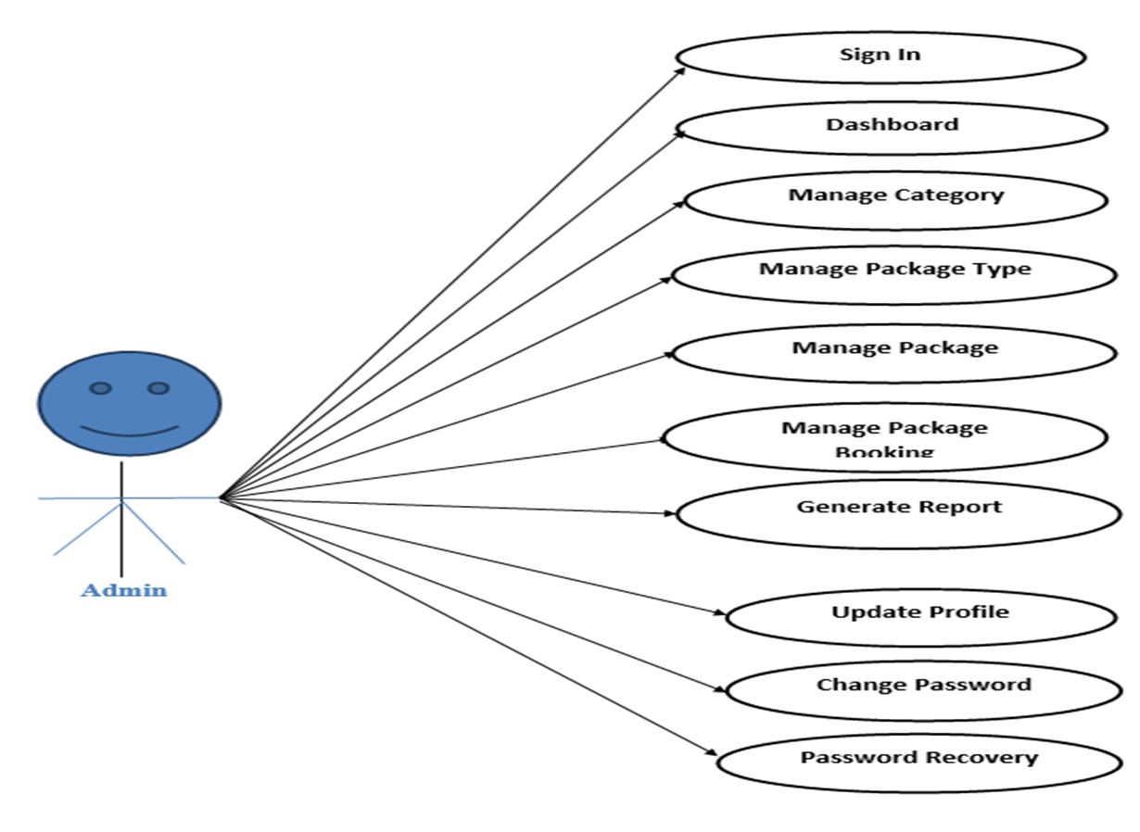
Use Case Diagram: Admin

Slide 15
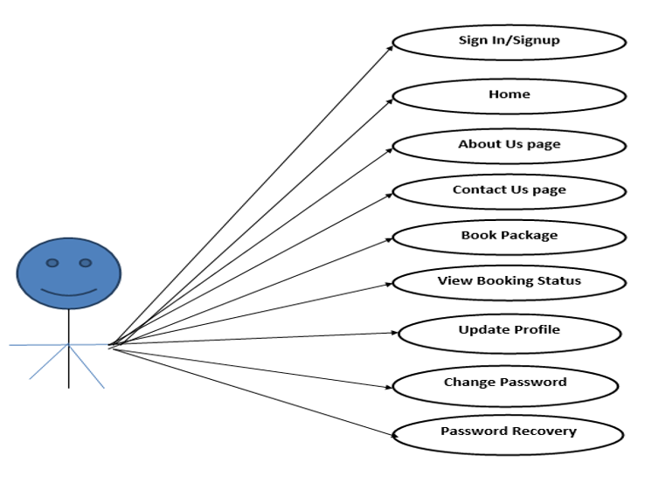
Use Case Diagram: User

Slide 16
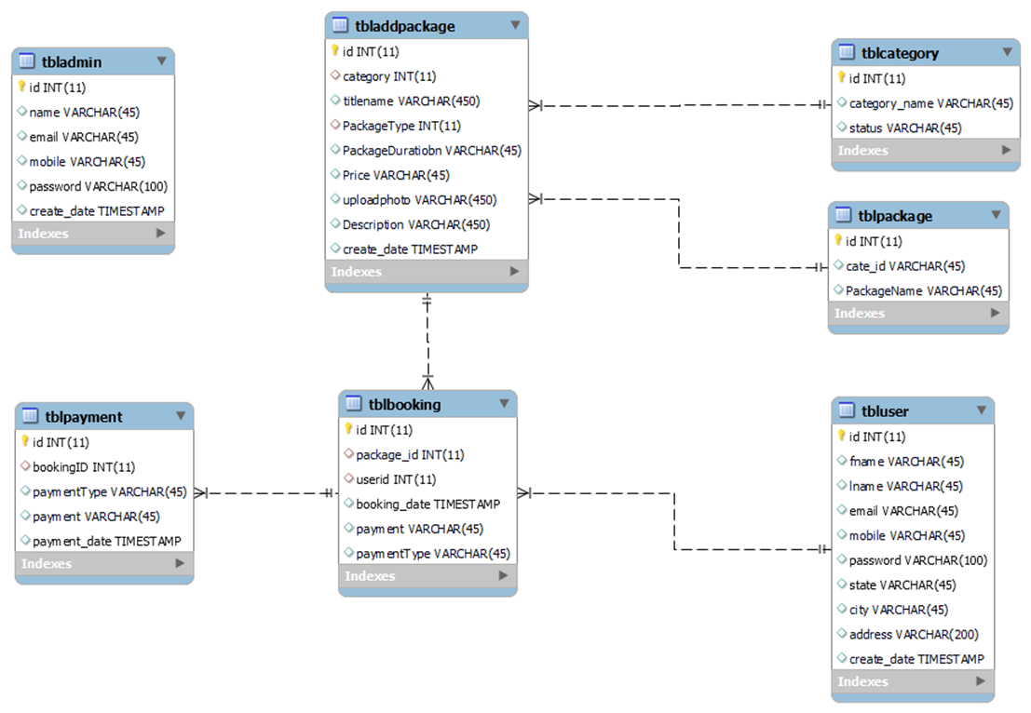
Class Diagram

Slide 17
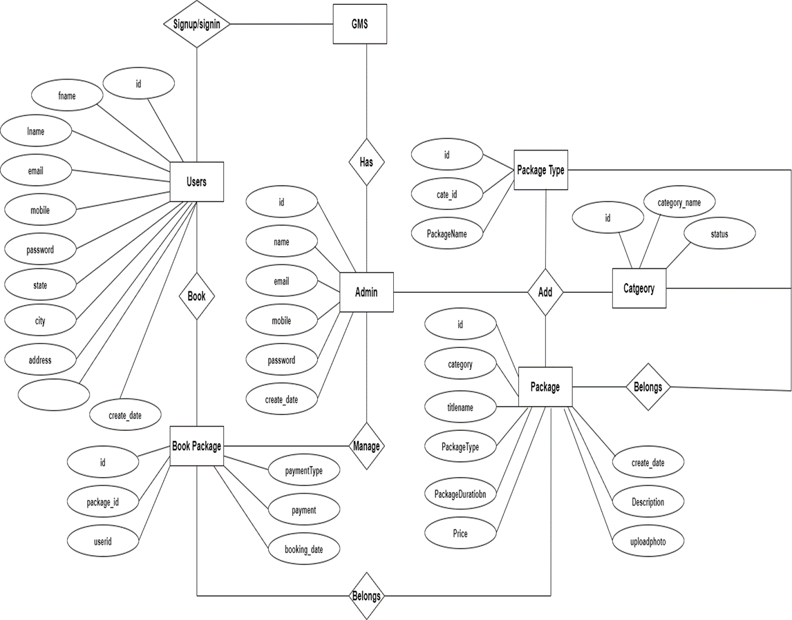
ER Diagram

Slide 18
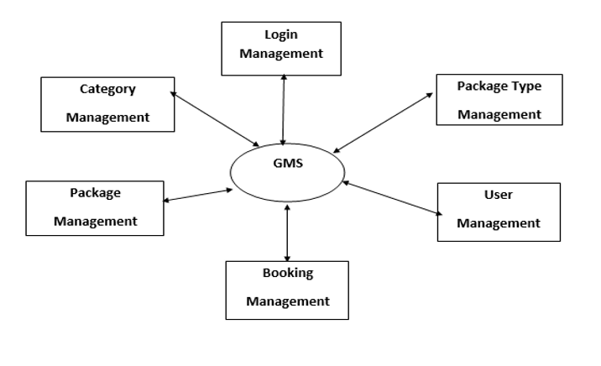
ZERO LEVEL DFD

Slide 19
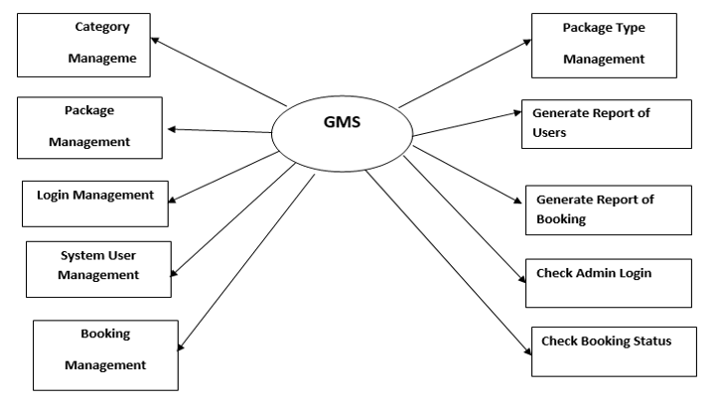
FIRST LEVEL DFD

Slide 20
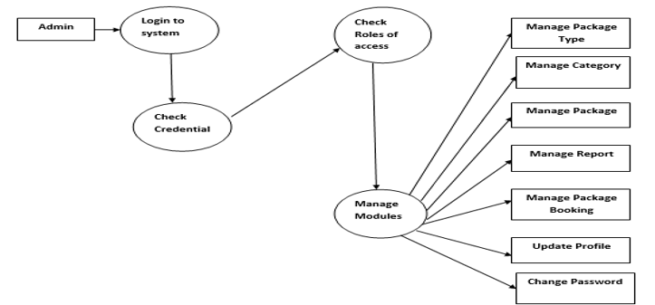
SECOND LEVEL DFD: ADMIN

Slide 21
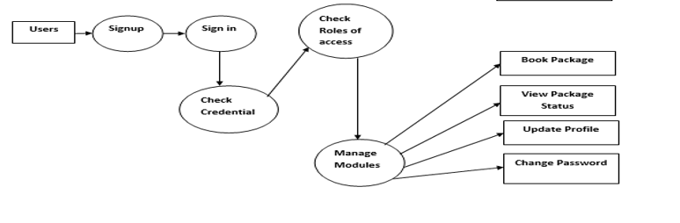
SECOND LEVEL DFD: USER

Slide 22
PROJECT MODULES
USER
ADMIN

Slide 23
USER MODULE
Users can visit the website and apply for gym packages.
Registration: One-time Registration is required to apply for any gym package.
Login: After registration, the user can log in and apply for the gym package.
Booking History: In this section, users can see booked packages and payment details also.
Profile: In this Section, User can update their profile.
Change Password: In this section, user can change their own password.

Slide 24

ADMIN MODULE
Admin can also update his profile, change the password and recover the password.
Dashboard: In this section, Admin can see the overview of bookings, listed packages, categories, and package types.
Categories: In this section, the admin can add, and delete the categories.
Package-Type: In this section, the admin can add, or delete the package type.
Packages: In this section, the admin can add, and edit packages.
Bookings: In this section, the admin checks the new booking and partial/ full payment bookings. Here admin can also update the payment details against a particular booking.
Report: In this section, Admin can generate the between-dates report for booking and registered users.

Slide 25
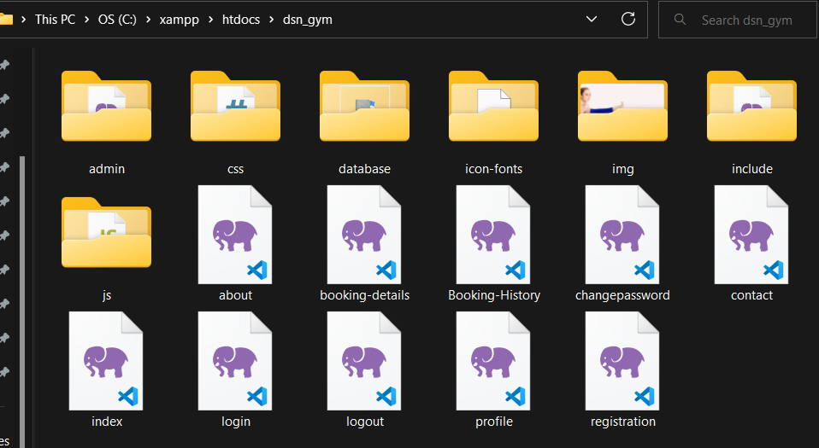
Implementation of The Project

Slide 26
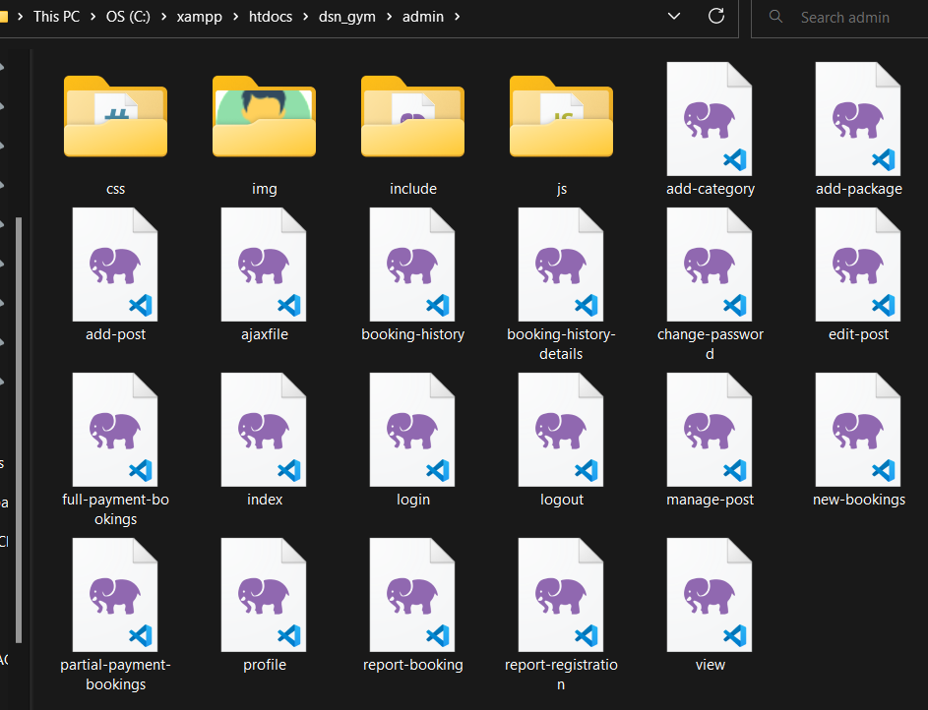

Slide 27
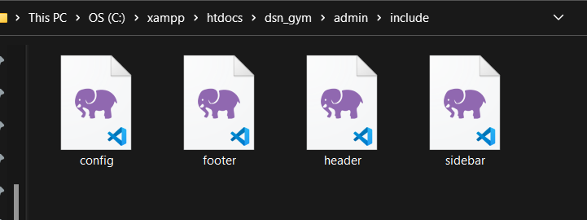
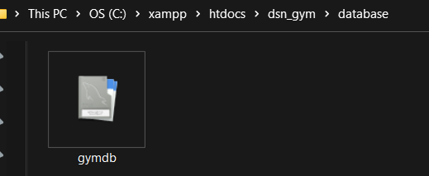

Slide 28
Screenshots of the Project

Slide 29
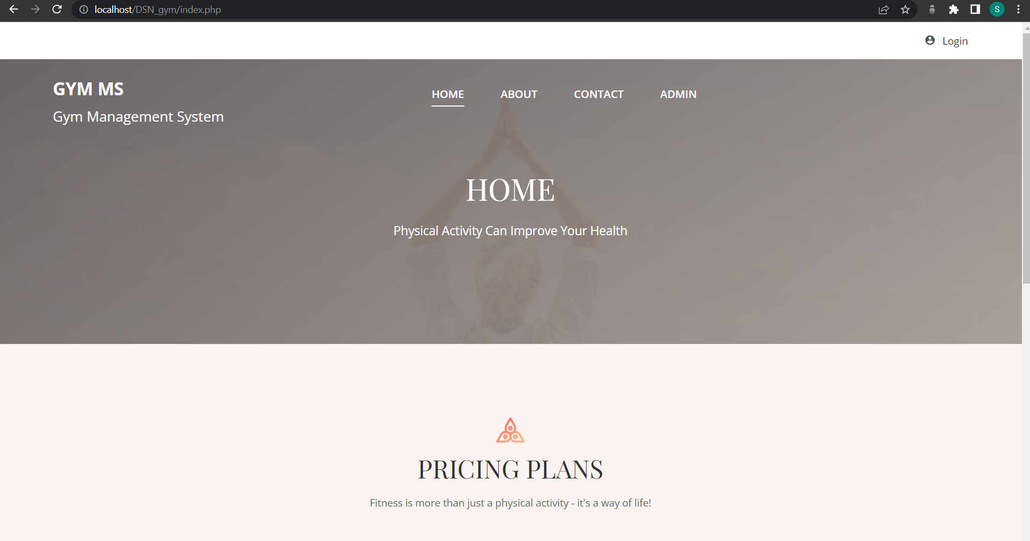

Slide 30
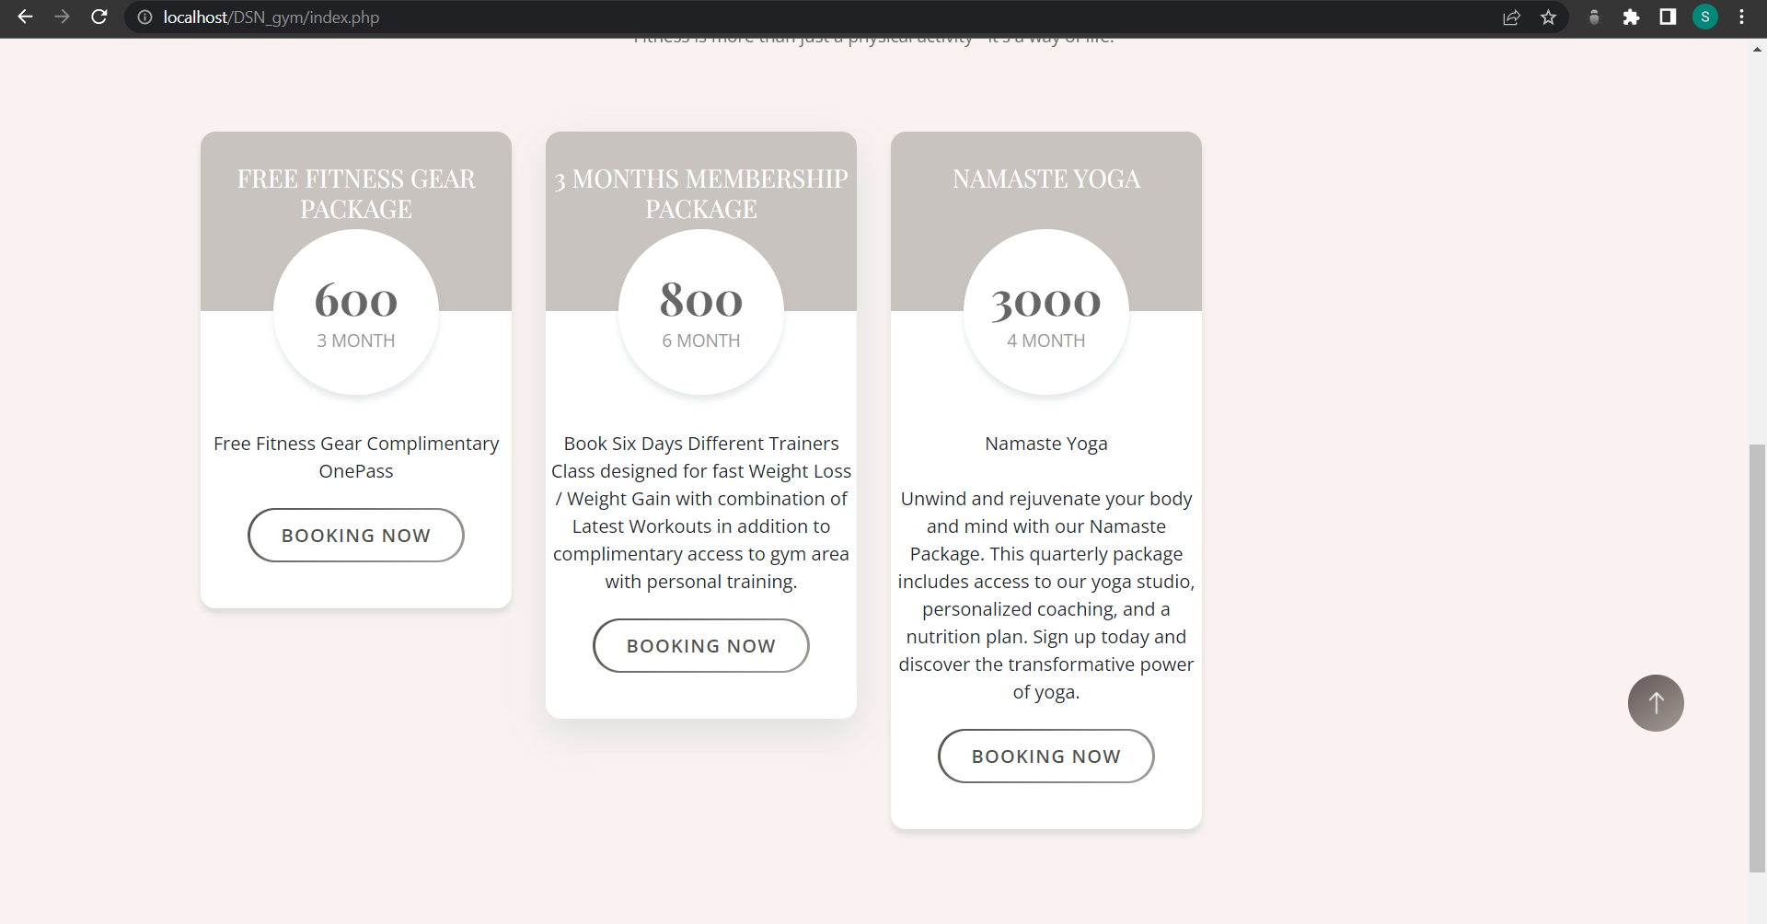

Slide 31
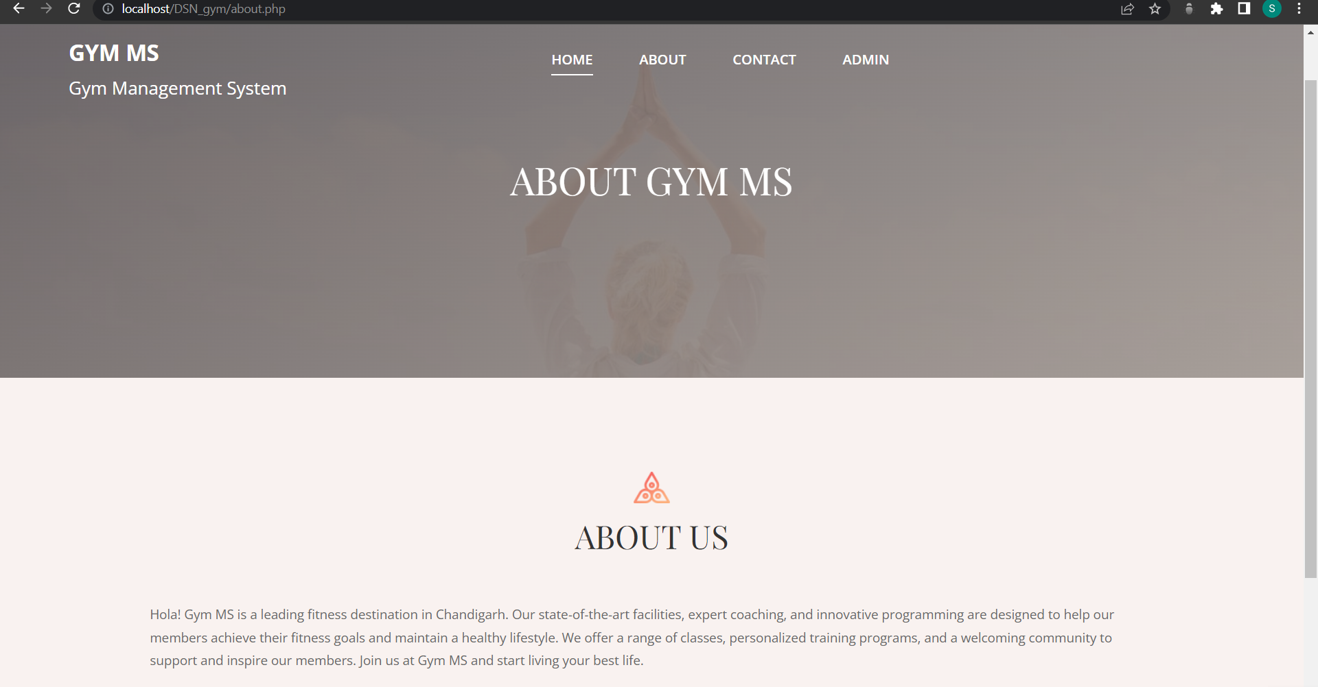

Slide 32
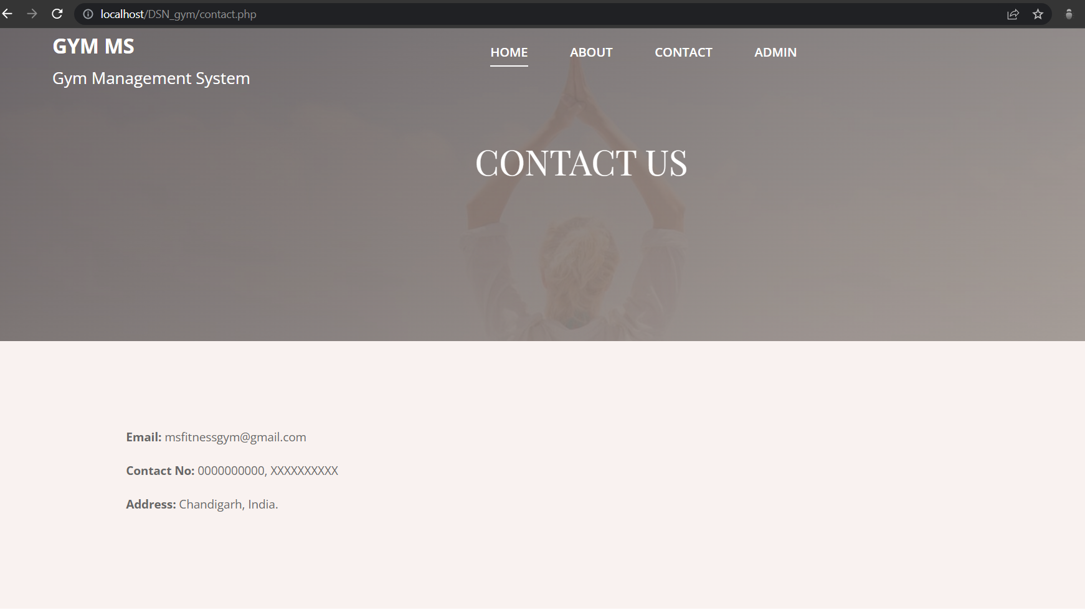

Slide 33
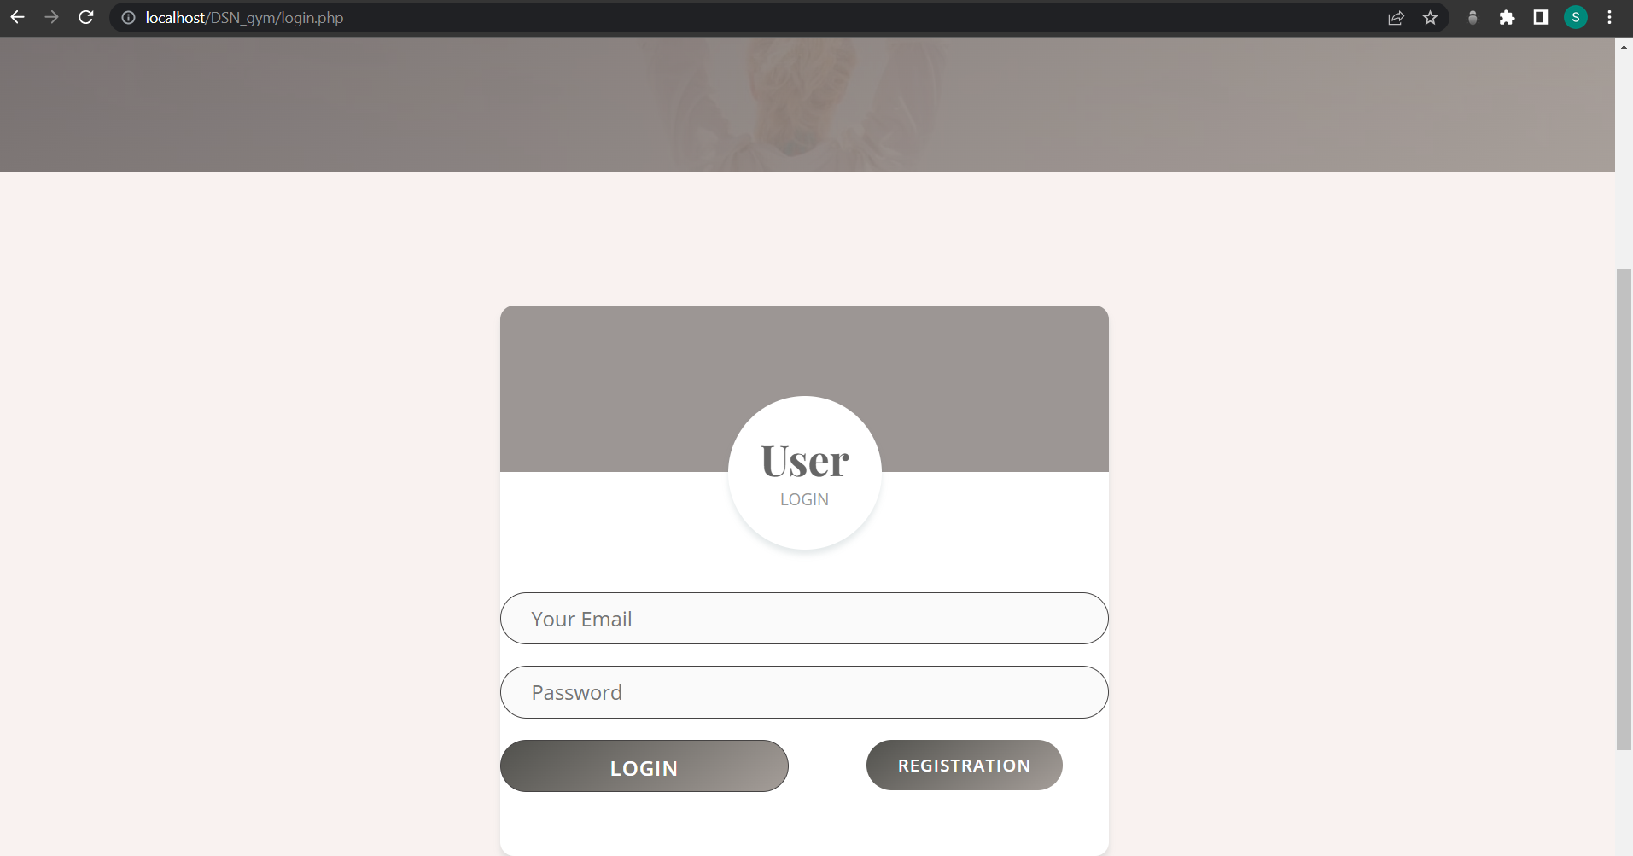

Slide 34
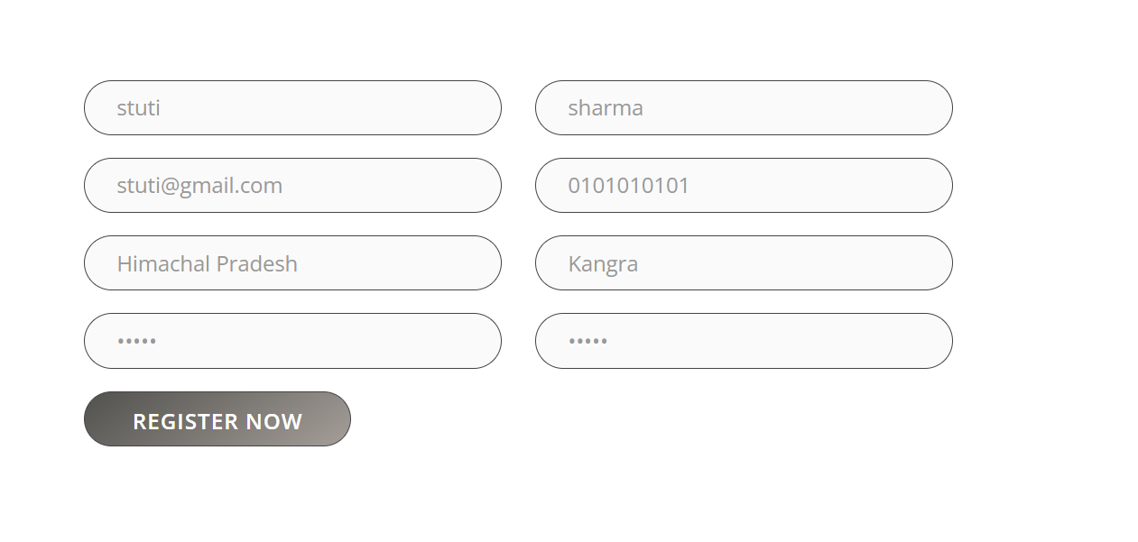

Slide 35
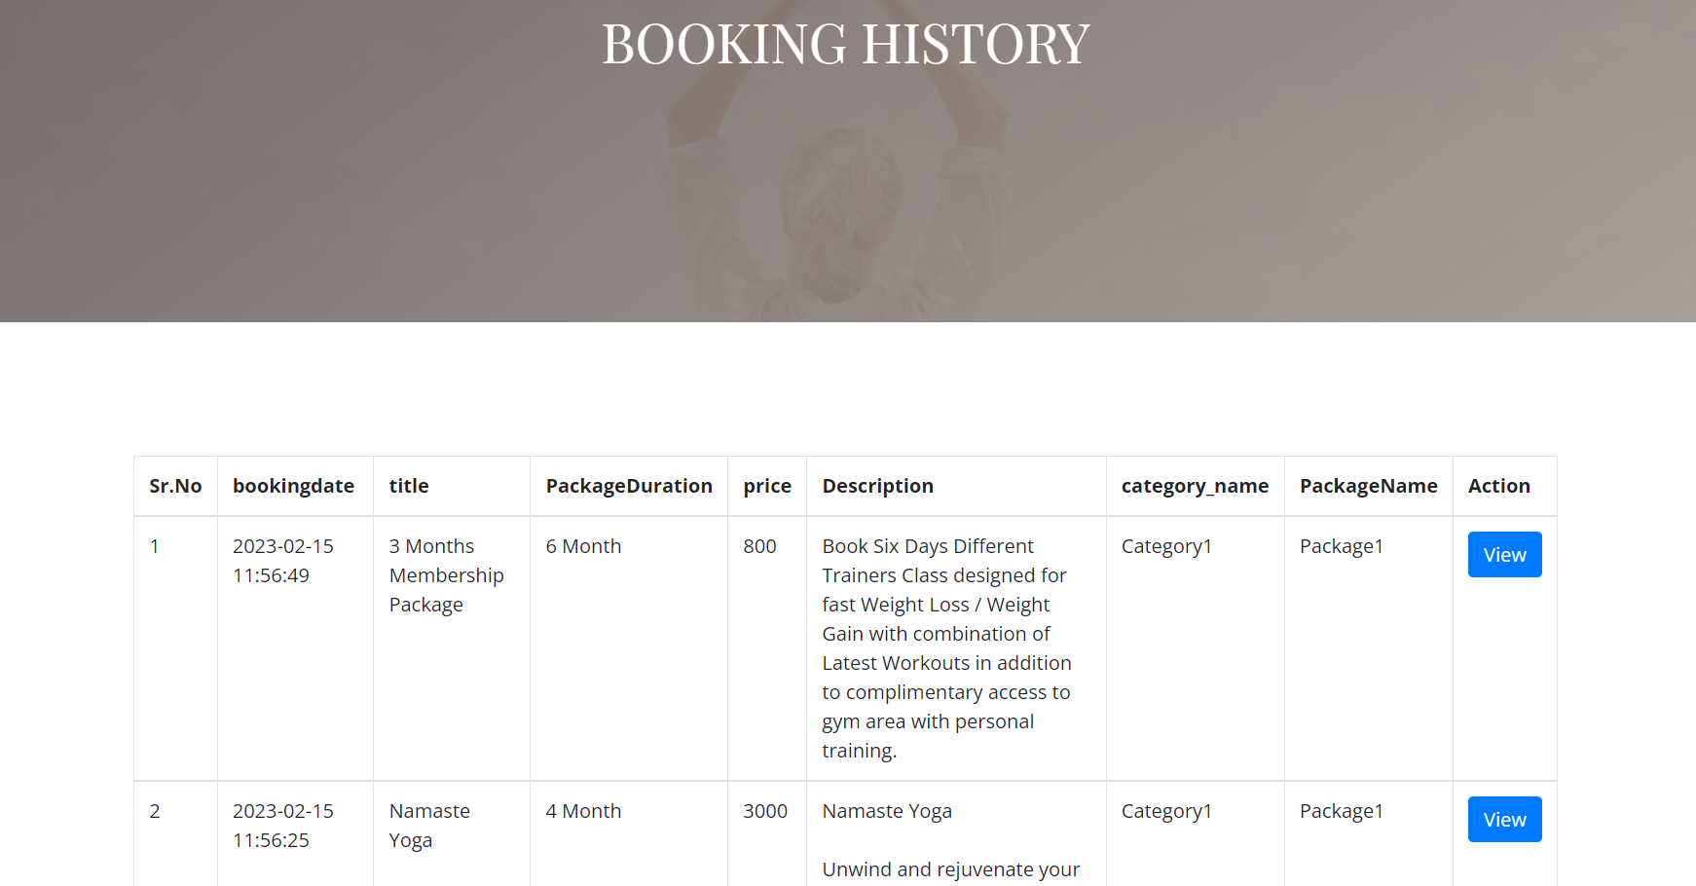

Slide 36
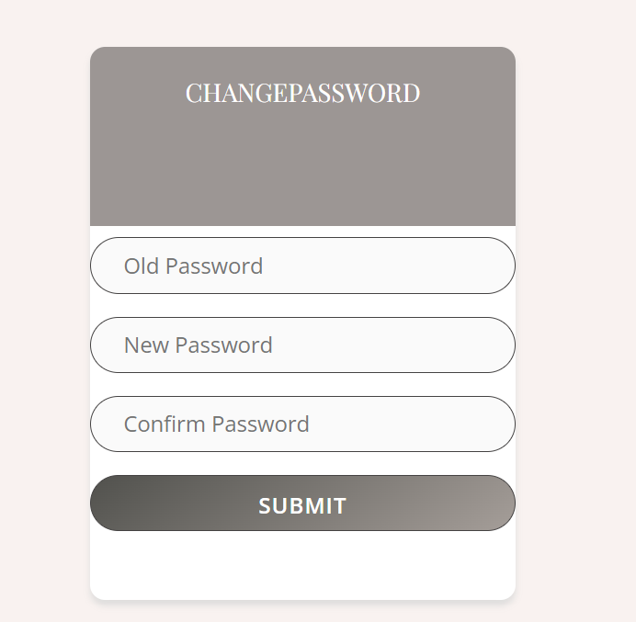

Slide 37
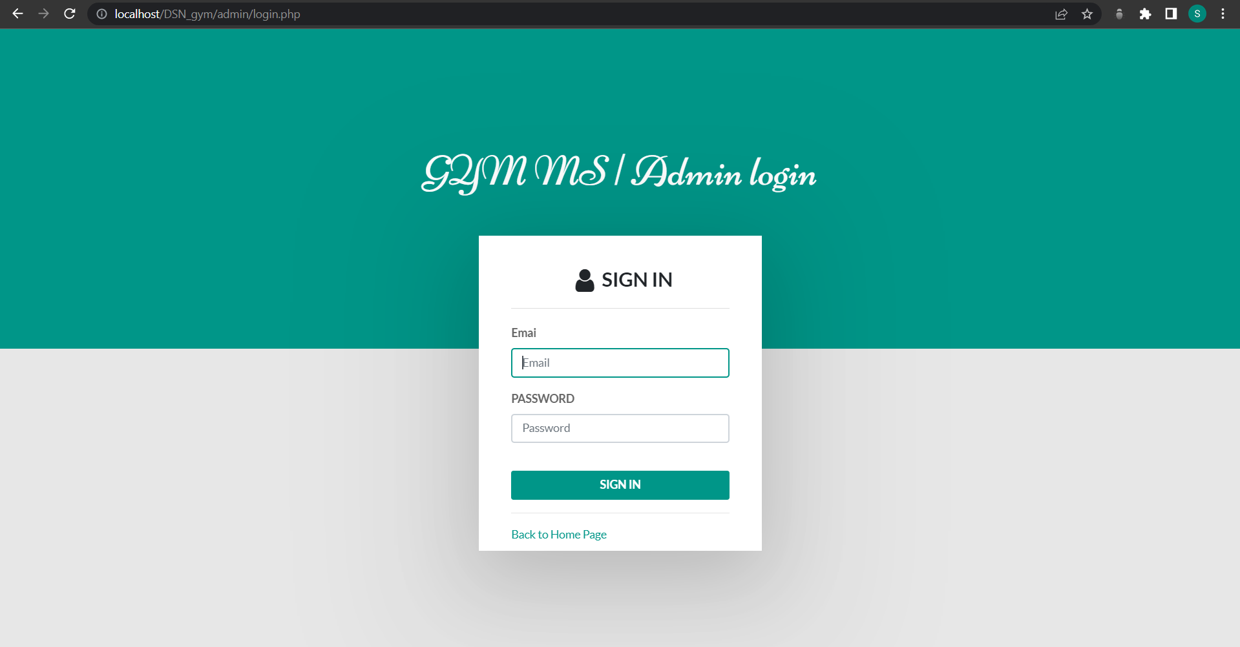

Slide 38
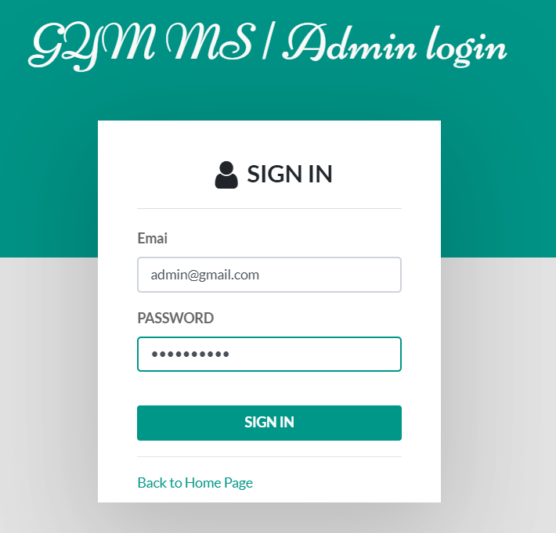

Slide 39
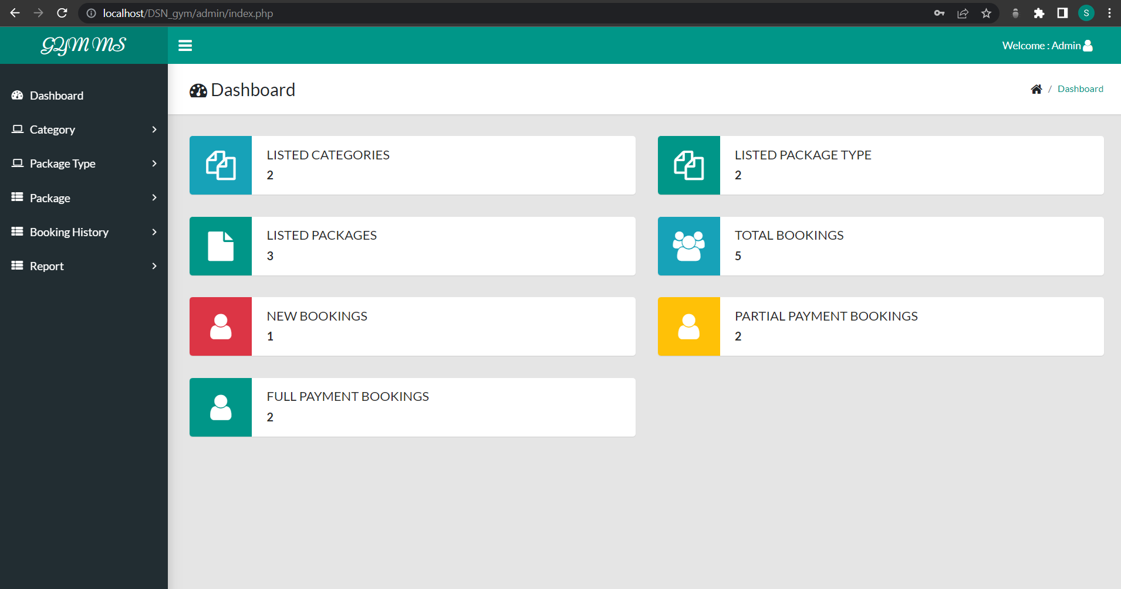

Slide 40
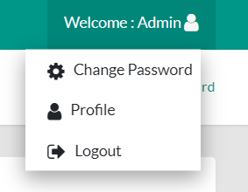
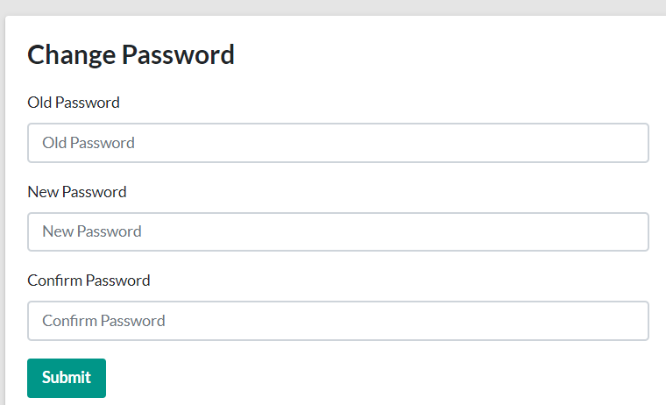
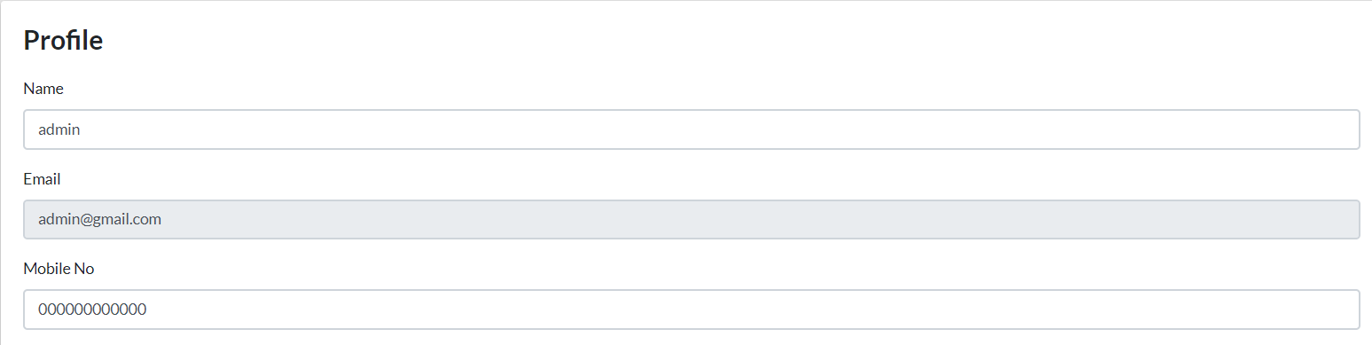

Slide 41
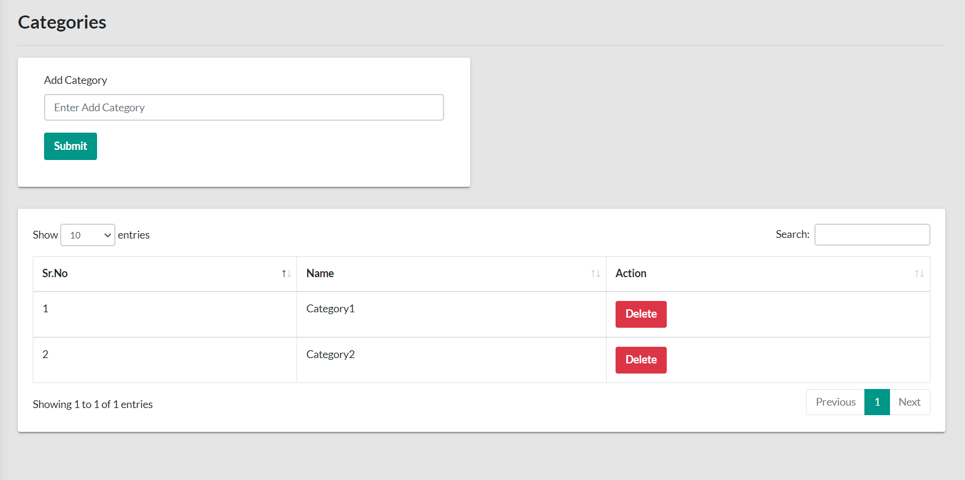

Slide 42
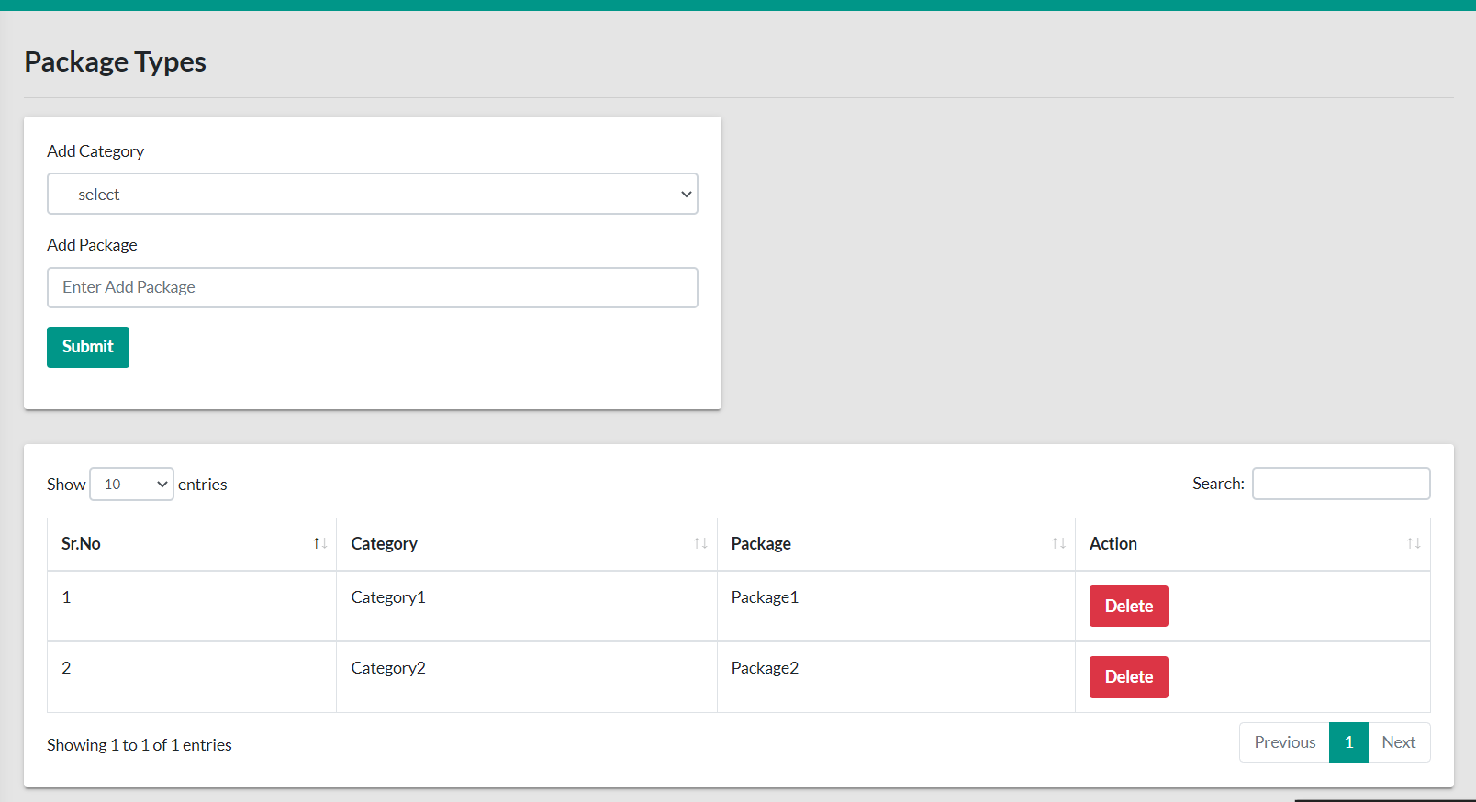

Slide 43
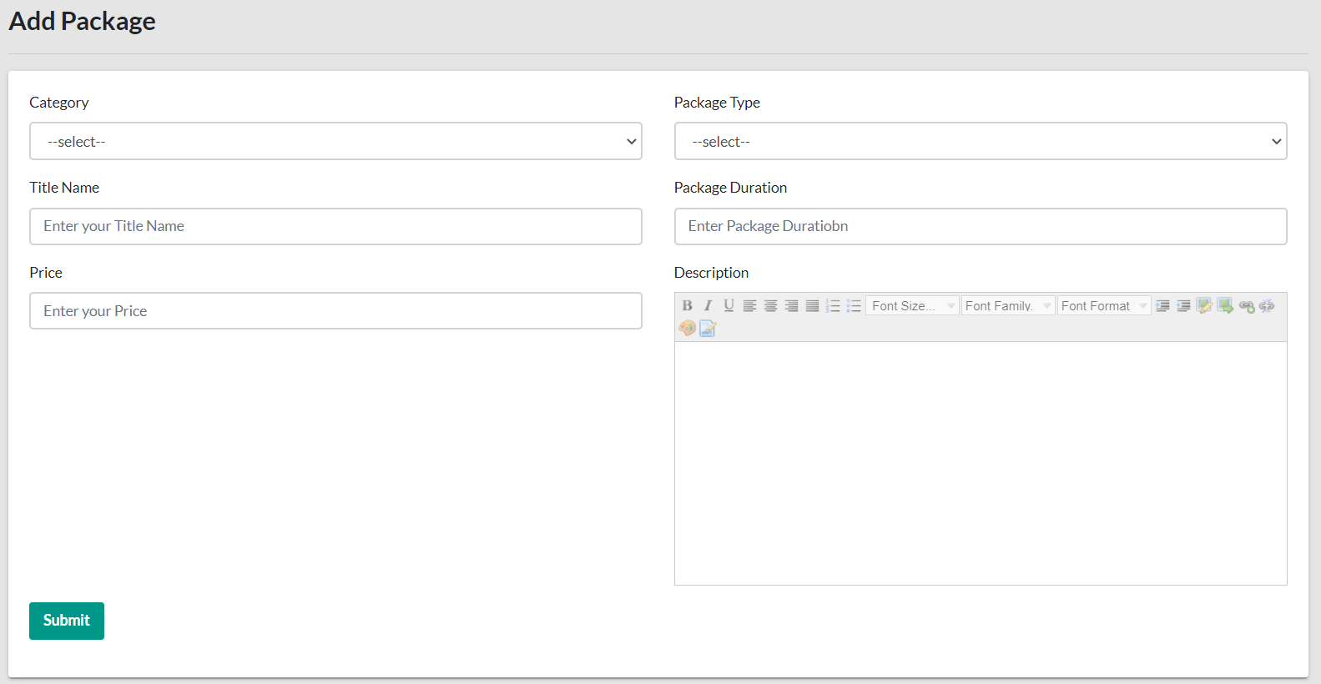

Slide 44
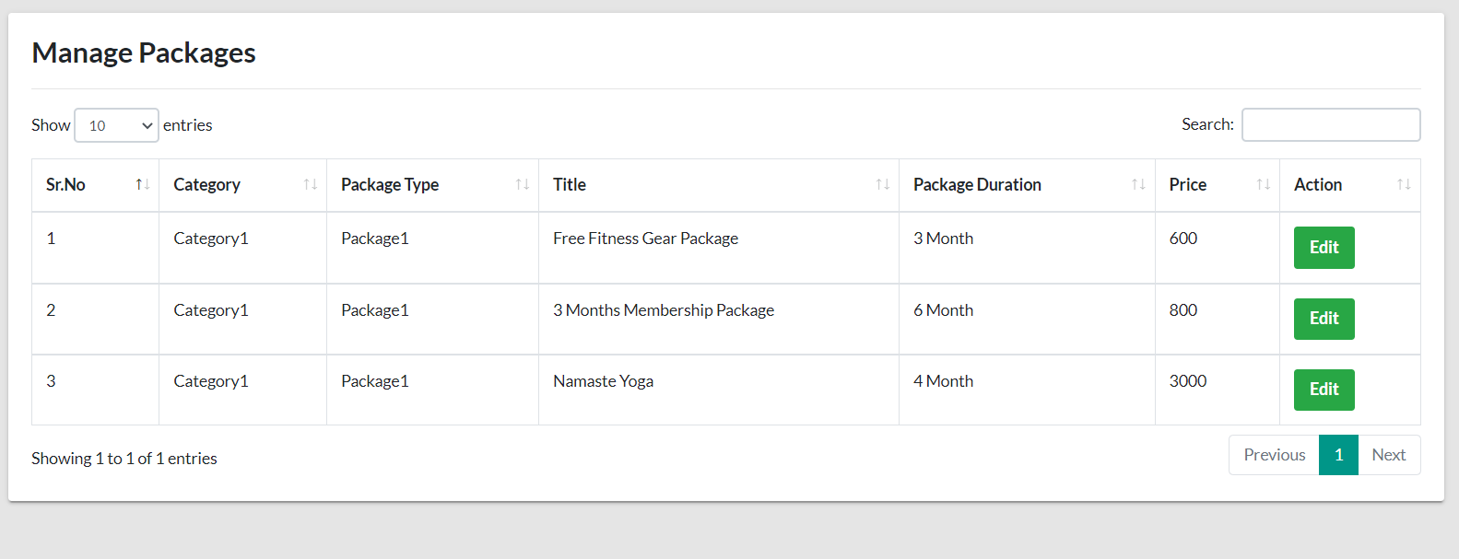

Slide 45
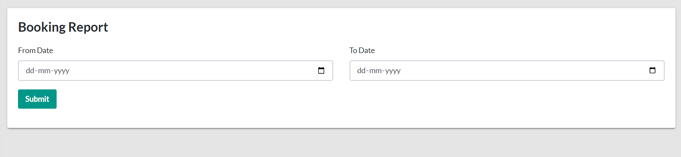
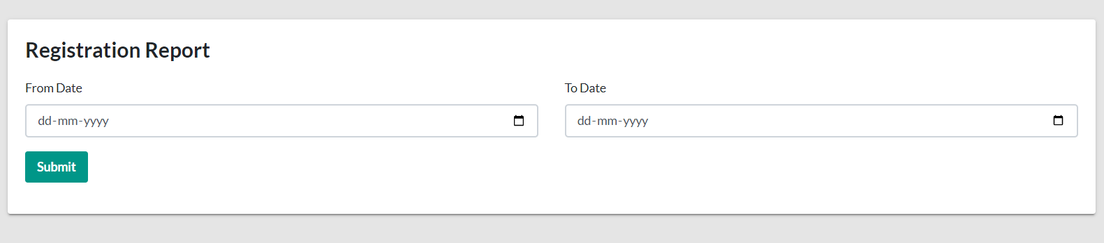

Slide 46

Thank you!

